Slide 1
Deep Learning Lecture 1 – INTRODUCTION

Slide 2
Teaching Team
Instructors:
Kailash Awati
Office: Rm 37, Level 3, Building 5D (Quay St)
Email: kailash.awati@uts.edu.au
Phone: 9514 4708
Alex Scriven
Email: Alexander.Scriven@uts.edu.au

Slide 3
OVERVIEW of Subject
This subject gives students a holistic understanding of deep learning, based on readings of research papers, coding exercises and practical assignments.
Three pillars:
(Some) mathematics
(skimming of) academic papers
(coding) coding
What’s not included:
Deep analysis of any particular architecture
Too much emphasis on deployment

Slide 4
OVERVIEW of Subject
The SLOs:
Form an intuitive and mathematical understanding of Vanilla Neural Networks
Articulate the strengths, weaknesses and use cases of a variety of Deep Learning neural network architectures.
Implement and optimise a variety of Deep Learning neural network architectures
Communicate the selection, training & analysis of deep learning models for business use cases in a context-appropriate manner
Synthesise and interpret relevant academic papers as well as other sources of knowledge relating to deep learning to build a model for current progress and potential future directions, commercial applications and ethical implications
Understand and utilise the latest work towards visualising and uncovering insights from traditionally ‘black-box’ models.

Slide 5
Block sessions Outline
Block Session | Details
1 – 4th April | Course introduction Introduction to neural networks, building a vanilla neural network from scratch
2 – 11th April | Software and hardware Training and optimization in depth
3 – 2nd May | Computer vision: types of tasks, CNNs in depth, classic to advanced architectures.
4 – 9th May | Sequence models: RNN, LSTM, Transformers & Attention Guest lecture & Lab: NLP in action
5 – 16th May | Generative Adversarial Networks Deep Reinforcement Learning (time permitting)
6 – 30th May | Model deployment. Interactive lecture-lab building and deploying a simple webapp for your model.

Slide 6
Assignments
AT | Details | Release | Due | Days
1A | Build and optimize a vanilla neural network from scratch (no frameworks) | 02/04/2019 | 21/04/2019 | 17
1B | Build and optimize an image classifier for a business use case | 02/05/2019 | 26/05/2019 | 24
2A | Literature review of key historic and modern academic papers on a chosen deep learning architecture. | 16/05/2019 | 02/06/2019 | 17
2B | Propose application of research undertaken in 2A to an industry problem | 16/05/2019 | 02/06/2019 | 17
3 | Build and optimize a sequence-based model for a business use case | 30/05/2019 | 20/06/2019 | 21
AT3 is groupwork. You may propose a more interesting project (*conditions apply!)

Slide 7

OVERVIEW of Subject
Important notes:
Nobody (including me) knows everything about every architecture. Just like ‘classic’ ML, we have areas we know better than others.
Diving deep into a particular branch you may very well end up more well versed than me.
Facilitator more than teacher
This course will focus on breadth rather than depth

Slide 8
A note on ‘A.I’
This graph appears often, though different people will have different views.
Be aware that most often these days when people say ‘A.I’ they either mean:
Software, that is distinctly none of the above (like rule-based systems)
A neural net architecture (CNN, RNN, DRL, GAN)
A.I
Machine Learning
Deep Learning

Slide 9
‘A.I’ is ‘locally’ smart
All you’re seeing now — all these feats of AI like self-driving cars, interpreting medical images, beating the world champion at Go and so on — these are very narrow intelligences, and they’re really trained for a particular purpose. They’re situations where we can collect a lot of data…
-Yann Lecun (Creator of CNN, Facebook Chief AI)
Key Take away: ‘Generalised A.I’ is a very different concept. Most A.I models break if taken slightly outside of what they are trained for

Slide 10
An A.I Example
Google Duplex (Voice assistant booking stunt)
‘Enter Duplex Google Duplex’s conversations sound natural thanks to advances in understanding, interacting, timing, and speaking.
At the core of Duplex is a recurrent neural network (RNN) designed to cope with these challenges, built using TensorFlow Extended (TFX). To obtain its high precision, we trained Duplex’s RNN on a corpus of anonymized phone conversation data.
https://ai.googleblog.com/2018/05/duplex-ai-system-for-natural-conversation.html

Slide 11
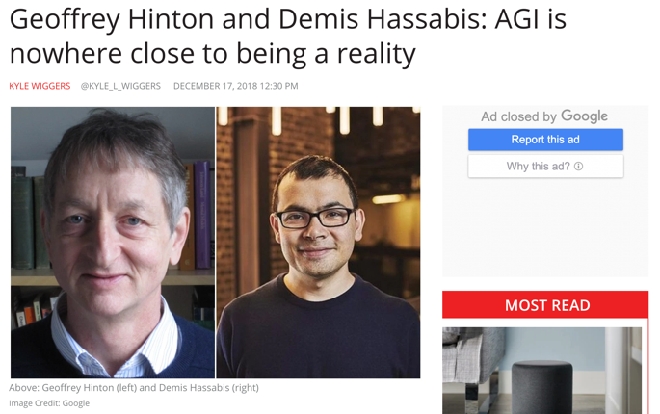
In other words…..
Hassabis cautions that they by no means suggest AGI is around the corner — far from it. Unlike the AI systems of today, he says, people draw on intrinsic knowledge about the world to perform prediction and planning….
We don’t have systems that can transfer in an efficient way knowledge they have from one domain to the next. I think you need things like concepts or extractions to do that
https://venturebeat.com/2018/12/17/geoffrey-hinton-and-demis-hassabis-agi-is-nowhere-close-to-being-a-reality/

Slide 12
To be perfectly blunt…..
“All the impressive achievements of deep learning amount to just curve fitting” – Judea Pearl

Slide 13
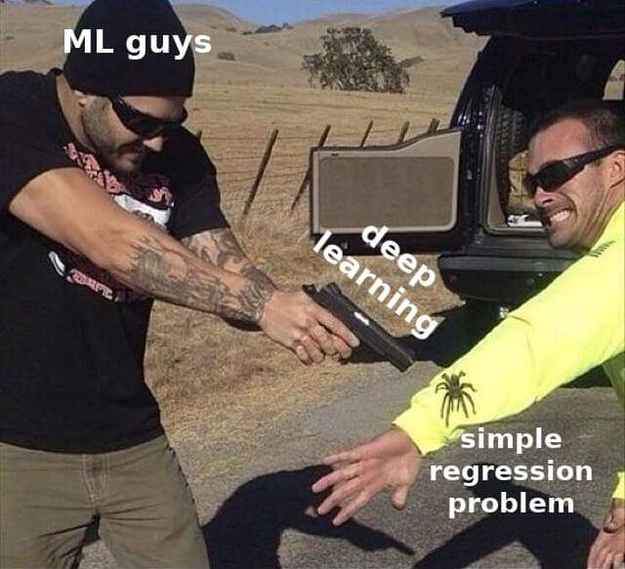
Visually speaking…

Slide 14
(An introduction to)
Neural Networks

Slide 15
Neural Networks
WHAT are Neural Networks
WHY are Neural Networks
HOW do we ‘Neural Networks’

Slide 16
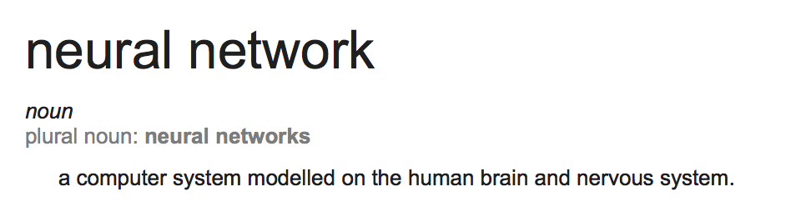
[WHAT] Neural Networks

Slide 17
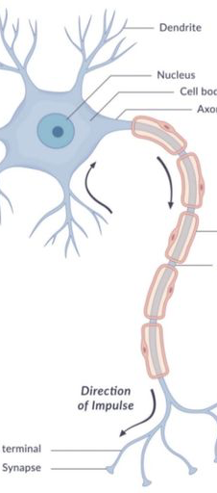
MODEL OF A NEURON
input synapses
The neuron is an information processing unit fundamental to a neural network. Neurons have three characteristics:
A set of input synapses (connecting links), each with a weight
An adding function to sum the input signals
An activation function to limit the output range of the neuron
adding function
activation function

Slide 18
Limitations of ‘Brain’ Model
The ‘Brain’ model is more of a historical name that has stuck around (probably because it sounds cooler than ‘multi-layer perceptron’) but has little real relation to our understanding of the brain today*.
In real life, ‘Neurons’:
Have many different types that are quite distinct from each other
The computations at the dendrites can be very complex functions
The simple weight-matrix approach is a vast simplification of the non-linear, dynamic system of interactions of our synapses.
*In computer-vision, the techniques hold closer semblance to real human cognition.

Slide 19
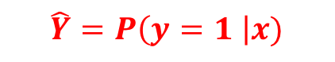
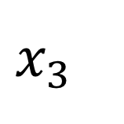
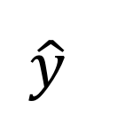
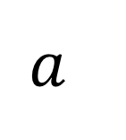
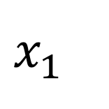
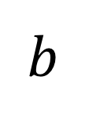
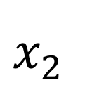
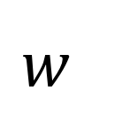
Let’s start with a neuron
Functions
$$x_{1}$$
Output
$$a$$
$$\hat{y}$$
Inputs
$$x_{3}$$
Magic
$$x_{2}$$
$$w$$
$$\hat{Y}=P\left(y=1 \right|x)$$
$$b$$
Probability
Weight Matrix
Bias Matrix

Slide 20
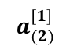
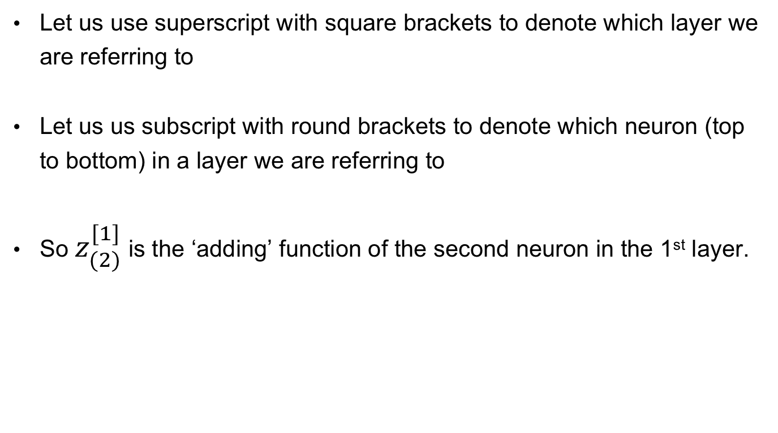
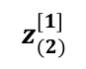
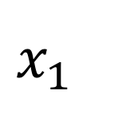
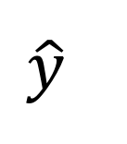
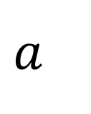
Some notation
Let us use superscript with square brackets to denote which layer we are referring to
Let us us subscript with round brackets to denote which neuron (top to bottom) in a layer we are referring to
So $z_{(2)}^{[1]}$ is the ‘adding’ function of the second neuron in the 1st layer.
$$x_{1}$$
$$z_{(2)}^{[1]}$$
$$a_{(2)}^{[1]}$$
$$a$$
$$\hat{y}$$

Slide 21
‘w’ and ‘b’
‘w’ is our matrix of weights that we will apply to each of our input data points.
(This becomes our hyperparameter to ‘tune’)
‘b’ is our bias term.
Similar to intercept in linear regression and serve much the same function (allows us to shift the function above the origin)
Has a value of 1 and is not connected to other nodes.
Without it, we are assuming our activation is through the origin
Y = mx + b

Slide 22
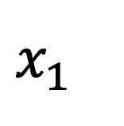
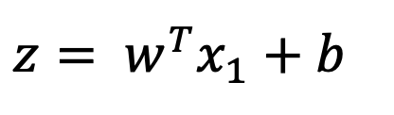
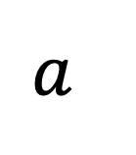
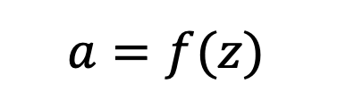
Inside a Neuron
$${z= w}^{T}x_{1}+b$$
$$a=f(z)$$
$$x_{1}$$
$$a$$
Adding function
Non-linear activation function
Why transpose W?

Slide 23
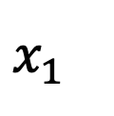
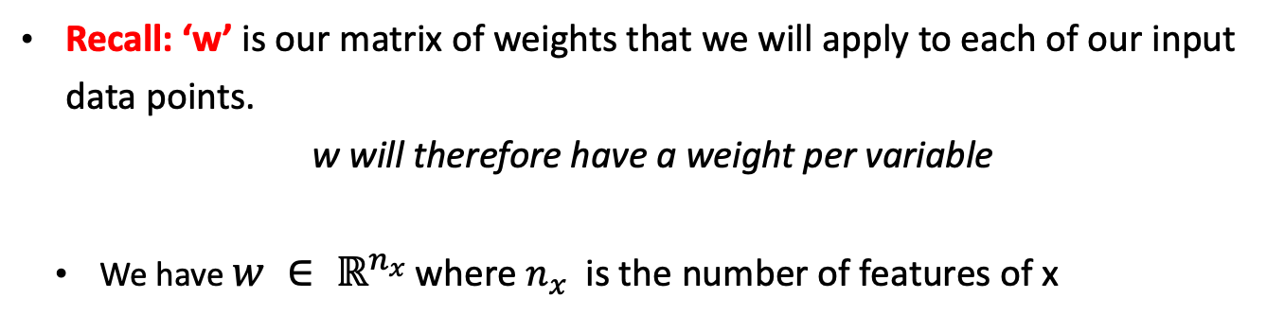
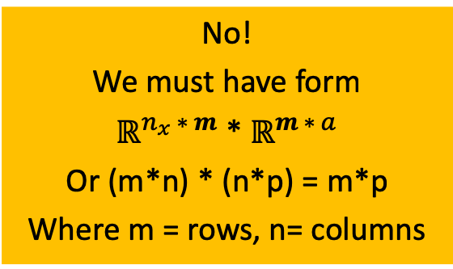
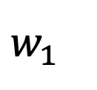
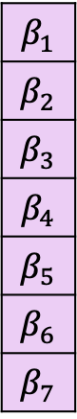
Why transpose W?
Recall: ‘w’ is our matrix of weights that we will apply to each of our input data points.
w will therefore have a weight per variable
We have $w ∈ ℝ^{n_{x} }$where $n_{x}$ is the number of features of x
$$β_{1}$$
$$β_{2}$$
$$β_{3}$$
$$β_{4}$$
$$β_{5}$$
$$β_{6}$$
$$β_{7}$$
Can I multiply these together currently?
Consider 1 training example of 10 features
No! We must have form $ℝ^{n_{x} ∗ m}$ * $ℝ^{m ∗ a}$ Or (m*n) * (n*p) = m*p Where m = rows, n= columns
$$x_{1}$$
$$w_{1}$$

Slide 24
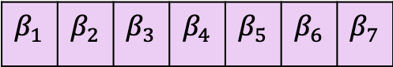
Why transpose W?
To allow us to undertake matrix calculus we must transpose something
$$β_{1}$$ | $$β_{2}$$ | $$β_{3}$$ | $$β_{4}$$ | $$β_{5}$$ | $$β_{6}$$ | $$β_{7}$$
(1*7) * (7*1) = (1*1)
Can I multiply these together currently?
Yes!
Columns(x) = rows(w)

Slide 25
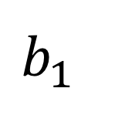
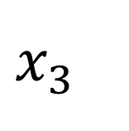
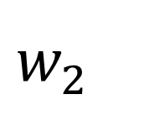
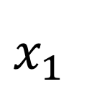
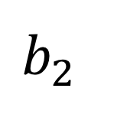
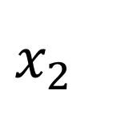
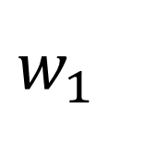
Neuron to ‘network’
$$x_{1}$$
Magic
$$x_{3}$$
Magic
$$a$$
$$\hat{y}$$
$$x_{2}$$
Magic
Input layer
Magic
$$w_{2}$$
$$b_{2}$$
$$w_{1}$$
Output layer
$$b_{1}$$
Hidden layer

Slide 26
RELATION TO LINEAR MODELS
A single neuron is effectively a generalised linear model, i.e. a linear regression model inside a function f
If the activation function (f) is the logistic function, then our single neuron model is the same as logistic regression
Neural networks go much further than linear models, due to the network of neurons

Slide 27
ACTIVATION FUNCTIONS
What is the activation for?
These are to scale our output and add non-linear properties
Why non-linear?
Consider if we we only undertook ‘adding’ functions at each node.
Then we are only making linear transformations. Linear-by-linear-by-linear.
Hence this is no more powerful than one linear node!

Slide 28
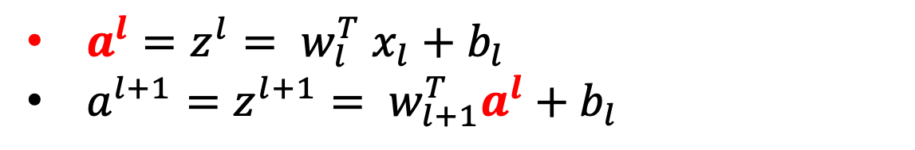
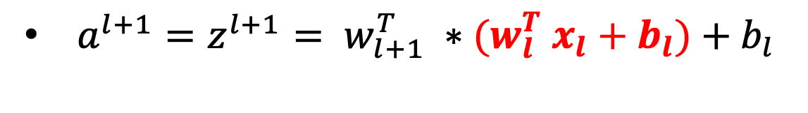
Let’s prove that!
Consider a NN with no activation function, we just do the multiplication step:
$a^{l}=z^{l}= w_{l}^{T} x_{l}+b_{l}$
$a^{l+1}=z^{l+1}= w_{l+1}^{T}a^{l}+b_{l}$
Substitute Line 1 into Line 2
$a^{l+1}=z^{l+1}= w_{l+1}^{T} ∗(w_{l}^{T} x_{l}+b_{l})+b_{l}$
We are just making linear transformations, no ‘curve’ to our function!

Slide 29
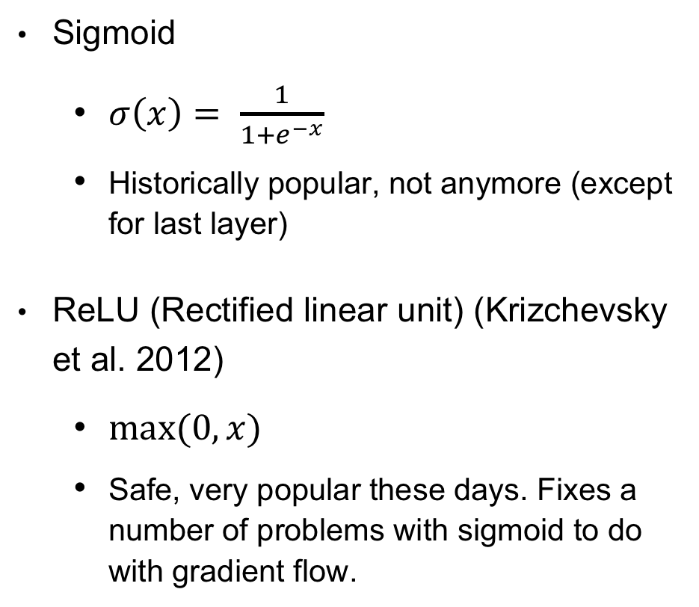
Some common activation functions
Sigmoid
$σ\left(x\right)= \frac{1}{1+e^{−x}}$
Historically popular, not anymore (except for last layer)
ReLU (Rectified linear unit) (Krizchevsky et al. 2012)
$max⁡(0,x)$
Safe, very popular these days. Fixes a number of problems with sigmoid to do with gradient flow.

Slide 30
Other Activation Functions

Slide 31
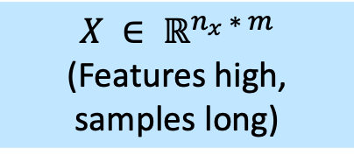
From instances to vectors
To ease the maths in our networks, we like to operate in vectors and matrixes.
This means that rather than a ‘for loop’ we can simply undertake efficient matrix calculations.
So let us take all our weights and stack them:
And the same for our Z, A and X (now using capital letters to denote a matrix).
$$X ∈ ℝ^{n_{x} ∗ m}$$
(Features high, samples long)

Slide 32
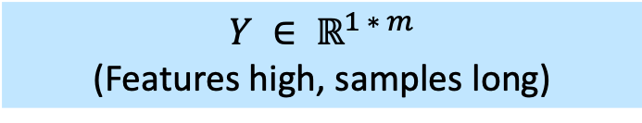
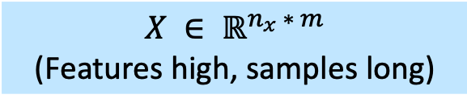
From instances to vectors
Given X is of the form:
$$X ∈ ℝ^{n_{x} ∗ m}$$
(Features high, samples long)
What is Y’s dimension?
$$Y ∈ ℝ^{1 ∗ m}$$
(Features high, samples long)

Slide 33
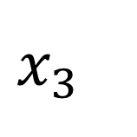
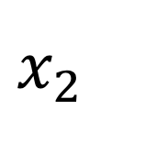
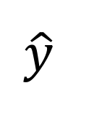
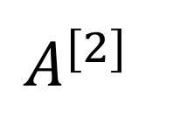
The matrix algebra through our network
$$x_{1}$$
$$x_{2}$$
$$A^{[2]}$$
$$\hat{y}$$
$$x_{3}$$
L2 is a function of L1
Note what are the later layers are modelling?
L1 is a function of L0

Slide 34
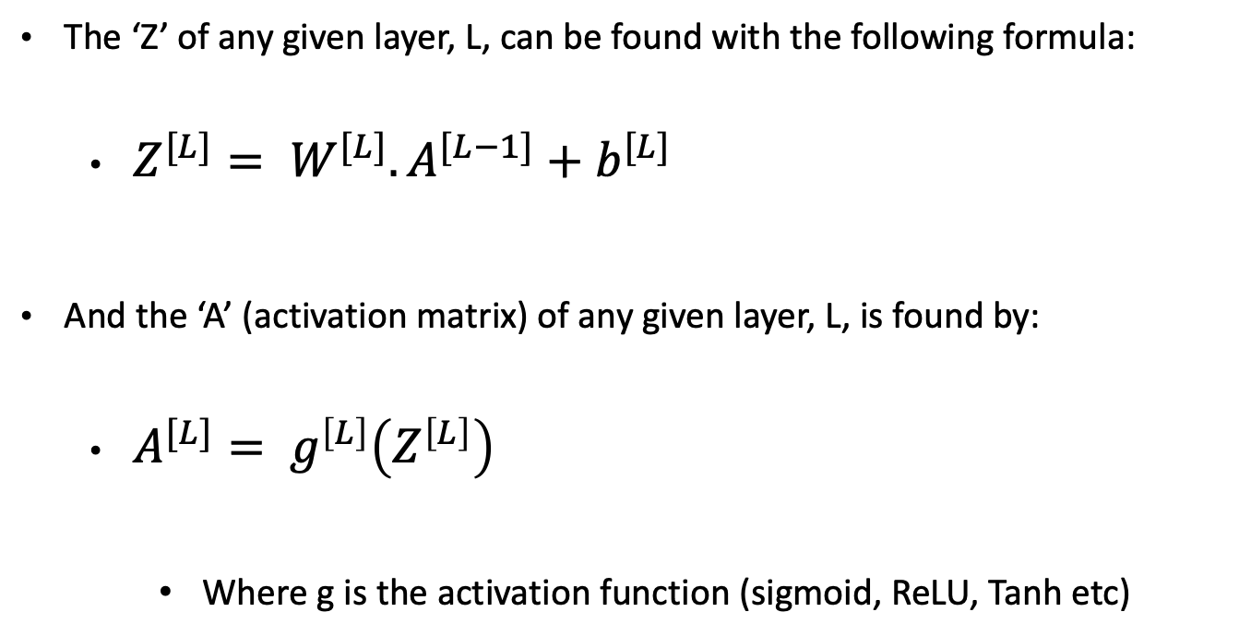
Generalizing the algebra
The ‘Z’ of any given layer, L, can be found with the following formula:
$Z^{[L]}= W^{[L]}.A^{[L−1]}+b^{[L]}$
And the ‘A’ (activation matrix) of any given layer, L, is found by:
$A^{[L]}= g^{\left[L\right]}\left(Z^{\left[L\right]}\right)$
Where g is the activation function (sigmoid, ReLU, Tanh etc)

Slide 35
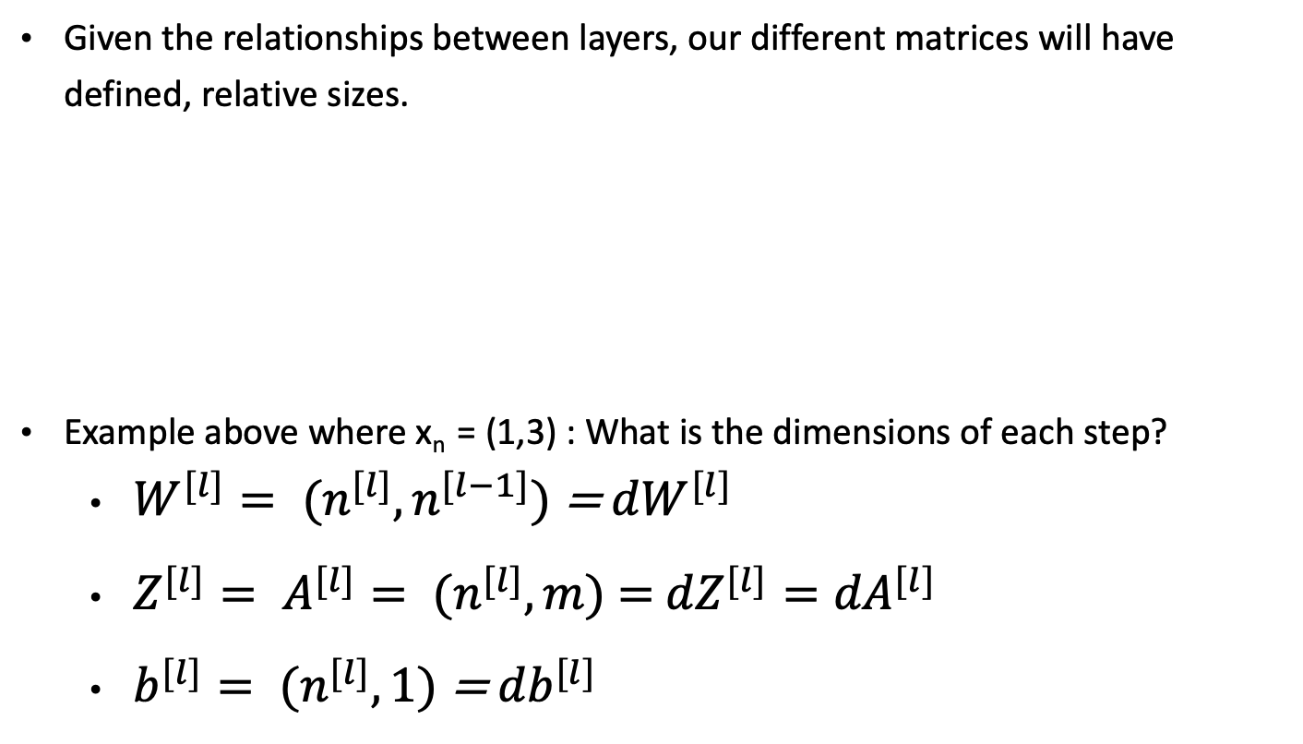
The size of our matrices
Given the relationships between layers, our different matrices will have defined, relative sizes.
Example above where x_{n} = (1,3) : What is the dimensions of each step?
$W^{[l]}= {(n}^{[l]},n^{[l−1]})$ = ${dW}^{[l]}$
$Z^{[l]}= A^{[l]}= {(n}^{[l]}, m)$ $=$ ${dZ}^{[l]}={dA}^{[l]}$
$b^{[l]}= {(n}^{[l]},1)$ = ${db}^{[l]}$

Slide 36
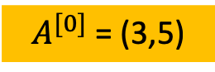
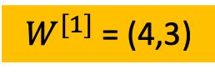
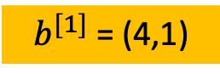


The size of our matrices
$A^{[0]}$ = (3,5)
$Z^{[1]}$ = (4,5)
$b^{[1]}$ = (4,1)
$W^{[1]}$ = (4,3)
Let’s calculate the sizes:
$W^{[l]}= {(n}^{[l]},n^{[l−1]})$ = ${dW}^{[l]}$ $Z^{[l]}= A^{[l]}= {(n}^{[l]}, m)$ $=$ ${dZ}^{[l]}={dA}^{[l]}$
$b^{[l]}= {(n}^{[l]},1)$ = ${db}^{[l]}$

Slide 37





Our matrices (formulas)
=
+
$A^{[0]}$ = (3,5)
$b^{[1]}$ = (4,1)
$Z^{[1]}$ = (4,5)
$W^{[1]}$ = (4,3)
$$Z^{[L]}= W^{[L]}.A^{[L−1]}+b^{[L]}$$

Slide 38


FEEDFORWARD NEURAL NETWORKS
What we have just seen is called a ‘feedforward neural network’
It is feedforward because information passes through in one direction only, from inputs, through the hidden layer and to the output
To simplify the matrix algebra we had before:

Slide 39


FEEDFORWARD NEURAL NETWORKS
It is common to have many hidden layers (a deeper neural network)

Slide 40
From NN to ‘DEEP LEARNING’
Primarily uses deep neural network architectures
More layers (deeper) allows for more flexible models
Requires much more computing power and larger data sets
Can learn non-linear transformations of data as features, and hierarchies of features

Slide 41
How big do these networks get?
https://vimeo.com/154085950
Alexnet (2012) had around 138M parameters,

Slide 42

Confused? – Key Takeaways
Lots of little ‘Neurons’ made up of:
A linear function (weight multiplication + bias)
A non-linear activation function
We stack lots of these to be able to be able to map complex data relationships and ‘weird’ data types that conventional models cannot.
$f_{3}=f_{2}(f_{1}\left(x\right))$
To really appreciate how it works and the beauty of the different models, make sure you understand the linear algebra occurring

Slide 43
Neural Networks
WHAT are Neural Networks
WHY are Neural Networks
HOW do we ‘Neural Networks’

Slide 44
WHY IT WORKS
With a sufficiently large (or deep) hidden layer(s), it is possible to represent any continuous function of the inputs with arbitrary accuracy
Think back to the bias-variance trade-off:
By using a network of neurons (think nested GLMs), we are providing a great deal more flexibility
The catch is that we are increasing variance – the model is more likely to overfit to our training data
One issue is that there is no clear guidance on selecting the width of each hidden layer (number of neurons) or the depth (number of hidden layers) for a given problem

Slide 45

OTHER TYPES
Convolutional neural network
Used in computer vision
Recurrent neural network
Sequence Data
LSTM
Sequence data (Time series)
Auto-encoder
Unsupervised learning
Deep Reinforcement Learning
‘Games’

Slide 46
Neural Networks
WHAT are Neural Networks
WHY are Neural Networks
HOW do we ‘Neural Networks’

Slide 47
How to ‘A.I’ in (6) simple steps
Initialize your network
Select number of hidden layers, number of hidden units per layer, activation functions
‘Feed Forward’
We have covered this essentially!
Calculate a loss
How bad did our model do?
‘Back propagate’
This will allow us to see how our weights affect our loss
Update weights
Repeat
(Optional – regularize)

Slide 48

One thing we missed! (Data Preparation)
We want to zero-center/ zero-mean the data.
Why?
So our output is not too sensitive to small changes in weight matrix.
To assist the gradient optimization path (link to sigmoid decline
We want to normalize the data.
Why?
So our variables can equally contribute
Different scales will make an elongated cost function and hence need a small learning rate step – training takes longer.
Not really needed for images – why?

Slide 49
Data Preparation: Extra
Look up whitening (Kessy et al., 2016)
Similar to PCA but components have unit variance
Can first perform PCA, then divide principal components by sqrt(eigenvalues)
Additional step could be ZCA (‘Mahalanobis whitening’)
Whitened data has minimal adjustments to the ‘space’ of the original data.
Generally for images, only zero-mean. For other DNN tasks, consider more pre-processing

Slide 50
Weight initialization
Proposition 1: Simply initialize the weights to zero?
Bad Idea – Why?
The weights would all do the same thing, output same values, receive same gradient etc.
Proposition 2: Add a small non-zero value
Ok – but has some issues (See AT1)
Proposition 3: Other, advanced methods
(See AT1)

Slide 51


Creating a loss function (cross-entropy)
Let us consider a binary outcome, then we can use a sigmoid loss function
Consider if Y=1
$\left(1−y\right)\log\left(1−\hat{Y }\right))$ becomes 0
We are left with $− (1)\log\left(\hat{Y}\right)$
What would be $\hat{Y}$ when we are really sure it IS? (0.999?)
log(0.990) = Zero!
Consider if Y=0
$−(ylog{\hat{Y})}$ becomes 0
We are left with $(1)\log\left(1−\hat{Y}\right)$
What would be $\hat{Y}$ when we are really sure it ISN’T? (0.001?)
log(0.999) = Zero!

Slide 52
BACK-PROPAGATION
Once we have decided on a neural network architecture, the model boils down to a set of weights
We cannot use optimisation methods from linear models to determine all these weights. Why?
We use the back-propagation algorithm instead:
Find the error at the output layer (i.e. classification error, MSE)
Use this error to adjust the weight between the last hidden layers and the output layer ➔ we back-propagate the error at the output layer to the hidden layer
Repeat 1 and 2 until all hidden layers are updated

Slide 53

BACK-PROPAGATION
The idea is that each hidden node is ‘responsible’ for some fraction of the error.
We divide the error according to the weight of the connection between each hidden node and the output – hidden nodes with a greater reduction in error get more weight

Slide 54


BACK-PROPAGATION
X
+
A
*
^2
Y
B
F
Z

Slide 55



BACK-PROPAGATION
X
+
A
*
^2
Y
B
F
Z

Slide 56


BACK-PROPAGATION
X
+
A
*
^2
Y
B
F
Z
The idea is that each hidden node is ‘responsible’ for some fraction of the error

Slide 57
BACK-PROPAGATION for Matrices
What if we don’t have scalars but have matrices?
Everything holds true, except we now get a jacobian matrix (first order partial derivatives of the weight matrices with respect to the loss function)
An example computational graph:
Matrix multiplication (then)
L2 transformation (sum of the square of each element) v

Slide 58




Jacobian walkthrough
$$\begin{matrix}0.1 & 0.5 \\ −0.3 & 0.8\end{matrix}$$
W
*
L2
A
F
f(x,W)
$$\begin{matrix}0.2 \\ 0.4\end{matrix}$$
x
$$\begin{matrix}0.1 & 0.5 \\ −0.3 & 0.8\end{matrix}$$
$$\begin{matrix}0.2 \\ 0.4\end{matrix}$$
????
=

Slide 59
Jacobian walkthrough
$$\begin{matrix}0.1 & 0.5 \\ −0.3 & 0.8\end{matrix}$$
W
*
L2
A
F
f(x,W)
$$\begin{matrix}0.2 \\ 0.4\end{matrix}$$
x
$$\begin{matrix}0.1 & 0.5 \\ −0.3 & 0.8\end{matrix}$$
$$\begin{matrix}0.2 \\ 0.4\end{matrix}$$
(0.1*0.22)+(0.5*0.4) = 0.22
(-0.3*0.2)+(0.8*0.4) = 0.26
=

Slide 60


Jacobian walkthrough
$$\begin{matrix}0.1 & 0.5 \\ −0.3 & 0.8\end{matrix}$$
W
$$\begin{matrix}0.22 \\ 0.26\end{matrix}$$
*
L2
A
F
f(x,W)
$$\begin{matrix}0.2 \\ 0.4\end{matrix}$$
x
$${||\begin{matrix}0.22 \\ 0.26\end{matrix}||}^{2}$$
????
=

Slide 61
Jacobian walkthrough
$$\begin{matrix}0.1 & 0.5 \\ −0.3 & 0.8\end{matrix}$$
W
$$\begin{matrix}0.22 \\ 0.26\end{matrix}$$
*
L2
0.116
A
F
f(x,W)
$$\begin{matrix}0.2 \\ 0.4\end{matrix}$$
x
$${||\begin{matrix}0.22 \\ 0.26\end{matrix}||}^{2}$$
=
(0.22*0.22)+(0.26*0.26) = 0.116

Slide 62

Jacobian walkthrough (backwards)
$$\begin{matrix}0.1 & 0.5 \\ −0.3 & 0.8\end{matrix}$$
W
$$\begin{matrix}0.22 \\ 0.26\end{matrix}$$
*
L2
0.116
A
F
f(x,W)
$$\begin{matrix}0.2 \\ 0.4\end{matrix}$$
x
????
1.00
First (1) is derivative of the output with itself.
Roll back one layer, what’s the function – how do we differentiate it?
$$\frac{\left.df(x\right)}{dx}where f\left(x\right)= x^{\left(2\right)}≫ f^{′}(x)= 2x= \left[\begin{matrix}2∗0.22 \\ 2∗0.26\end{matrix}\right](1.00)=\left[\begin{matrix}0.44 \\ 0.52\end{matrix}\right]$$

Slide 63




Jacobian walkthrough (backwards)
$$\begin{matrix}0.1 & 0.5 \\ −0.3 & 0.8\end{matrix}$$
????
W
$$\begin{matrix}0.22 \\ 0.26\end{matrix}$$
*
L2
0.116
Q
F
f(x,W)
$$\begin{matrix}0.2 \\ 0.4\end{matrix}$$
x
$$\left[\begin{matrix}0.44 \\ 0.52\end{matrix}\right]$$
1.00
Roll back another layer, how do we do this?
We need to create our jacobian to do this.
$$\frac{dq}{dw} where \left[\begin{matrix}q_{11} \\ q_{21}\end{matrix}\right]=\left[\begin{matrix}w_{11} \\ w_{21}\end{matrix} \begin{matrix}w_{12} \\ w_{22}\end{matrix}\right]∗\left[\begin{matrix}x_{11} \\ x_{21}\end{matrix}\right]= \left[\begin{matrix}w_{11}x_{11} + \\ w_{21}x_{11}+\end{matrix} \begin{matrix}w_{12}x_{21} \\ w_{22}x_{21}\end{matrix}\right]$$
(We can also use a shortcut)
$\frac{\left.d(b^{T}x\right)}{dx}=b$ where our (b=X) and (X=W)

Slide 64


Jacobian walkthrough (backwards)
$$\begin{matrix}0.1 & 0.5 \\ −0.3 & 0.8\end{matrix}$$
????
W
$$\begin{matrix}0.22 \\ 0.26\end{matrix}$$
*
L2
0.116
Q
F
f(x,W)
$$\begin{matrix}0.2 \\ 0.4\end{matrix}$$
x
$$\left[\begin{matrix}0.44 \\ 0.52\end{matrix}\right]$$
1.00
$$\frac{dq}{dw} where \left[\begin{matrix}q_{11} \\ q_{21}\end{matrix}\right]=\left[\begin{matrix}w_{11} \\ w_{21}\end{matrix} \begin{matrix}w_{12} \\ w_{22}\end{matrix}\right]∗\left[\begin{matrix}x_{11} \\ x_{21}\end{matrix}\right]= \left[\begin{matrix}w_{11}x_{11} + \\ w_{21}x_{11}+\end{matrix} \begin{matrix}w_{12}x_{21} \\ w_{22}x_{21}\end{matrix}\right]$$
$\frac{\left.d(b^{T}x\right)}{dx}=b$ where our (b=X) and (X=W)
$$\left[\begin{matrix}0.2 & 0.4\end{matrix}\right]∗ \left[\begin{matrix}0.44 \\ 0.52\end{matrix}\right]=\left[\begin{matrix}0.088 \\ 0.176\end{matrix} \begin{matrix}0.104 \\ 0.208\end{matrix}\right]$$

Slide 65




Jacobian walkthrough (backwards)
$$\begin{matrix}0.1 & 0.5 \\ −0.3 & 0.8\end{matrix}$$
W
$$\begin{matrix}0.22 \\ 0.26\end{matrix}$$
$$\left[\begin{matrix}0.088 \\ 0.176\end{matrix} \begin{matrix}0.104 \\ 0.208\end{matrix}\right]$$
*
L2
0.116
Q
F
f(x,W)
$$\begin{matrix}0.2 \\ 0.4\end{matrix}$$
x
$$\left[\begin{matrix}0.44 \\ 0.52\end{matrix}\right]$$
1.00
Key takeaway:
The fundamental principle of the ‘Chain Rule’ can be applied to matrices in order to determine the influence of weight matrix elements on final output (loss)

Slide 66
Updating the weights - Gradient descent
In multiple dimensions, the gradient is the vector of partial derivatives along each dimension.
Think of it like a person standing somewhere in a valley of lots of ups and downs. Your goal is to find the lowest point (and efficiently!)
The height is the loss function, X-Y-Z are your parameters
(do we have only 3 parameters? How many do we have?)
Start somewhere
Take a bunch of little steps around us and see where is the steepest slope (negative derivative)
Then take a small step in that direction
Repeat

Slide 67
Updating the weights - Gradient descent
The small step is termed the learning rate:
If α is too small, gradient descent will take a long time
If α is too large, you can fail to converge or overshoot the minimum (diverge)
https://www.youtube.com/watch?v=WnqQrPNYz5Q
https://www.youtube.com/watch?v=IHZwWFHWa-w

Slide 68
Gradient descent

Slide 69
AT1 briefing + Lab
Walkthrough briefing PDF and notebook

